Slide 1
Build – FHIR Shorthand

Slide 2
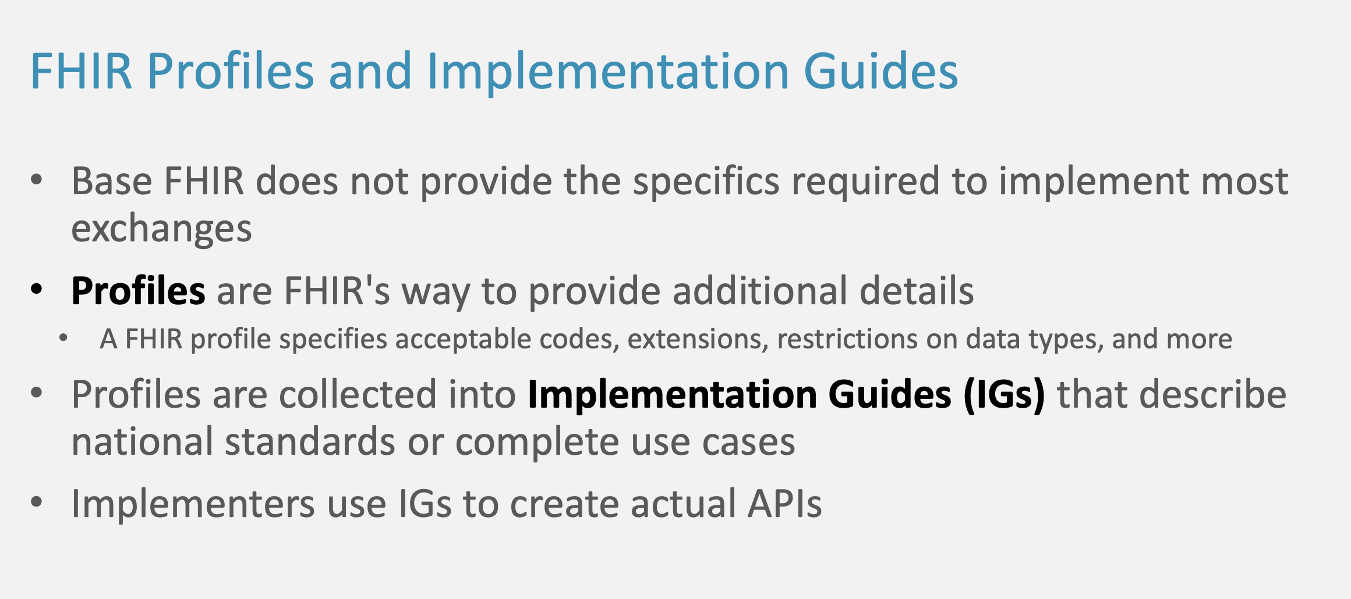

Slide 3
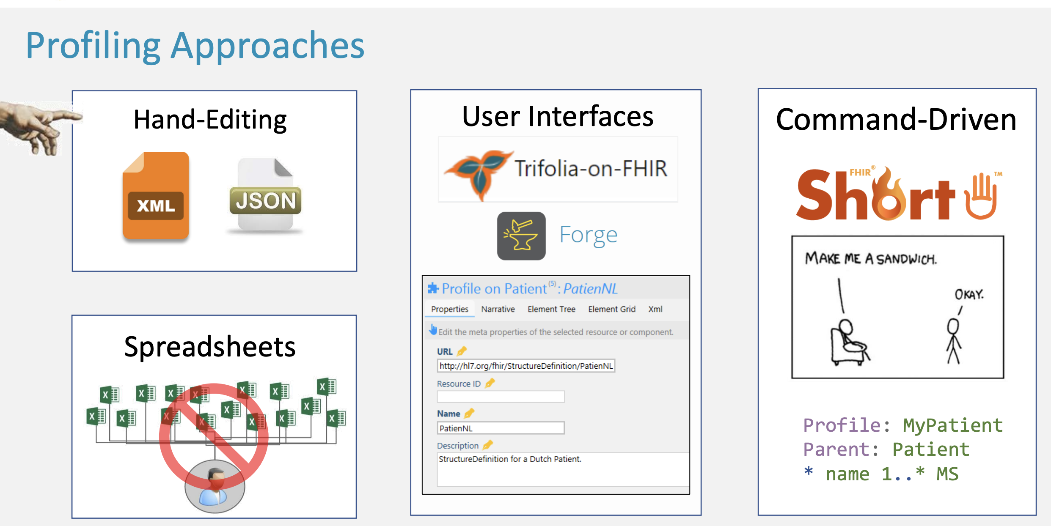

Slide 4
FHIR Shorthand
Language for defining the contents of FHIR Implementation Guides (IG)
Motivation:
Need for scalable, fast, user-friendly tools for IG creation and maintenance
See http://hl7.org/fhir/uv/shorthand/

Slide 5



Slide 6

Sushi
With FSH you create shorthand notations for your artifacts
FSH compiler
Sushi expands FSH to an actual FHIR resource
See https://fshschool.org/docs/sushi/

Slide 7
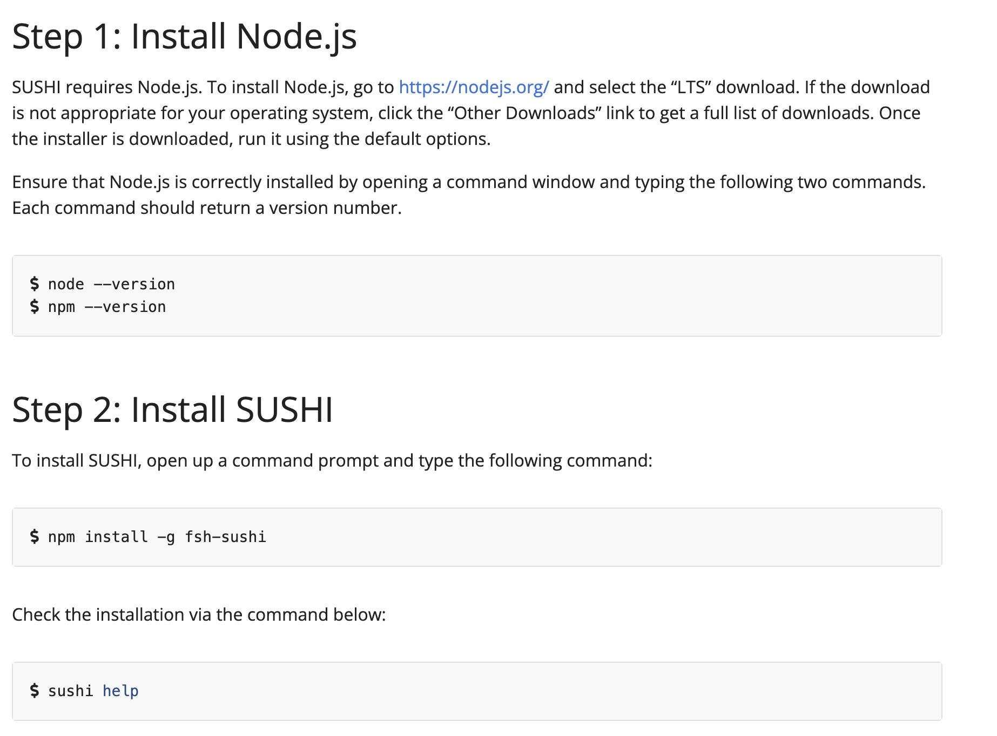
Install Sushi

Slide 8
GoFSH
Turns FHIR artifacts into FSH
fshing-trip
Flag for gofsh to do a roundtrip: from FHIR → FSH → FHIR
Compares the two FHIR artifacts and displays differences
See https://fshschool.org/docs/gofsh/

Slide 9
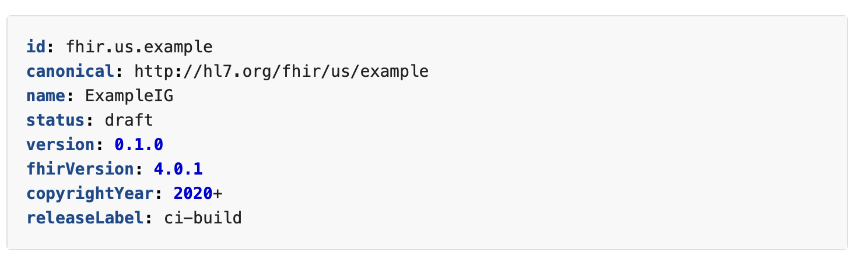
Setting up a project
Install NodeJS and Sushi
Create a working directory for your project
Create a YAML file for configuring Sushi

Slide 10
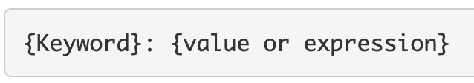
Examples of FSH – setting up a profile
Start with a keyword indicating the FHIR concept
Add additional keywords to supply details
Example: Profile: MyPatient Parent: Patient Description: "Example Patient profile."

Slide 11
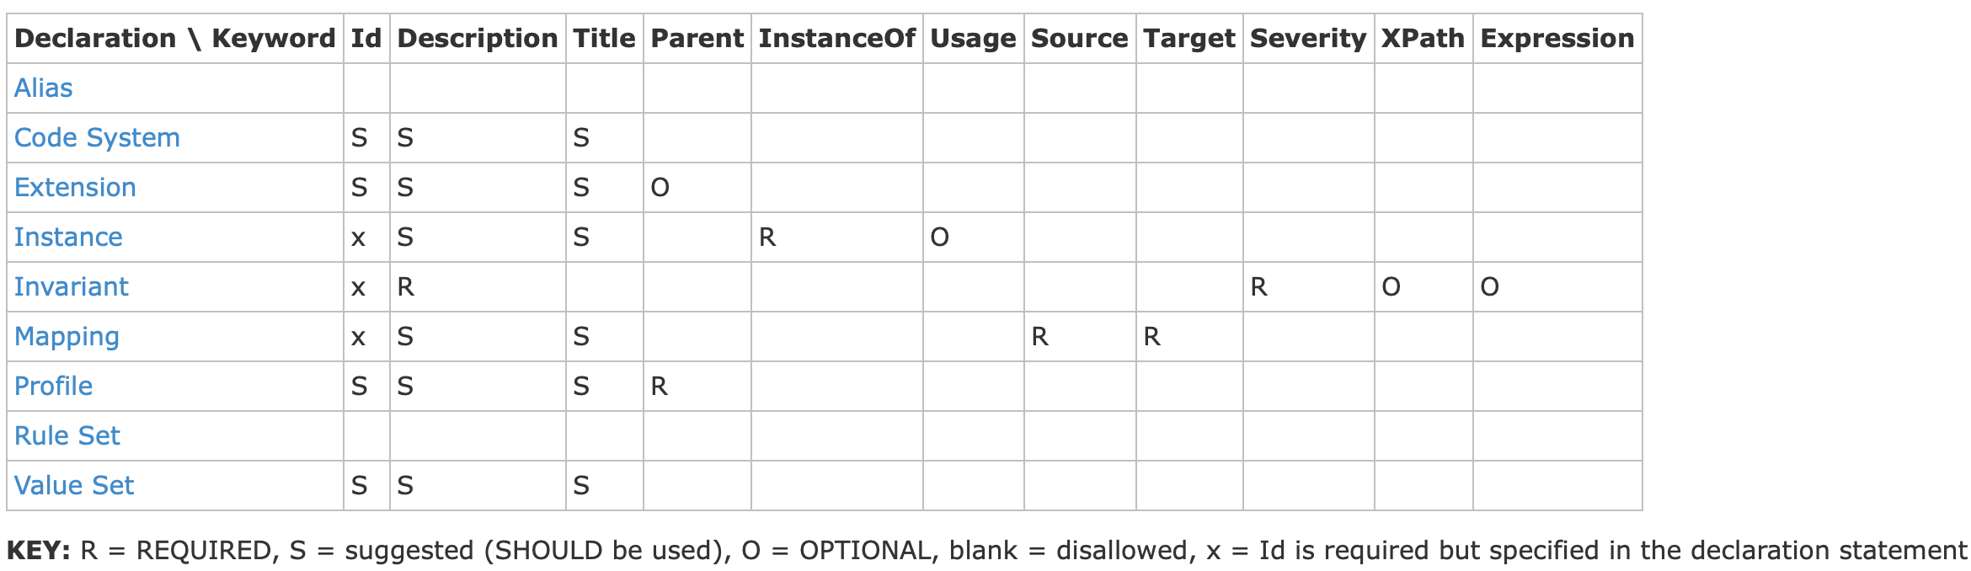
Overview of keywords
Taken from:
http://hl7.org/fhir/uv/shorthand/reference.html#defining-items

Slide 12
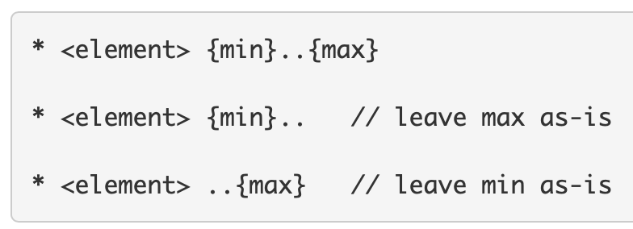
Examples of FSH – constraining cardinality
Add lines for each rule, always starting with an asterisk (*)
Example cardinality constraints: * birthDate 1.. * name 1..*
See http://hl7.org/fhir/uv/shorthand/reference.html#rules-for-profiles-extensions-and-instances

Slide 13
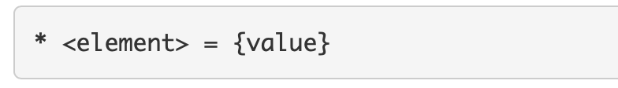
Examples of FSH – fixing values
To fix a value, use an assignment rule
Example assignment: * active = true * code = LNC#69548-6 "Display value for this code"
See http://hl7.org/fhir/uv/shorthand/reference.html#assignment-rules

Slide 14
Using FSH
Exercise FP036 – First Constraints (FSH)

Slide 15
FSH – Deriving profiles

Slide 16
Examples of FSH – derived profiles
When you need to derive a profile from another than the core spec, you can use its name or canonical after the ‘Parent’ keyword: Profile: MyPatient2 Parent: MyPatient Description: "Second Patient profile."

Slide 17
Using FSH
Exercise FP045 – Complex constraints - FSH

Slide 18
FSH – Creating extensions

Slide 19
Examples of FSH – setting up an extension
Start with the Extension keyword
Add additional keywords (Id, Description and Title) to supply details
Example: Extension: MyPatientExtension Title: Extension on Patient Description: "Example Patient extension."

Slide 20
Examples of FSH – adding simple extension
A simple extension will have a URL and a value
URL comes from Id and default canonical from settings
Add the type for the value: * value[x] only string

Slide 21
Examples of FSH – adding context to extension
Each extension will need to specify a context: where can the extension be used
This is a field in the StructureDefinition, so you need the ‘^’ notation to access that: * ^context[+].type = #element * ^context[=].expression = "Patient"
Note that FSH now also has the Context keyword for this, but not all older tools will work with that

Slide 22
Examples of FSH – adding complex extension
A complex extension will have a URL and subextensions that have a name and value
First create the structure * extension contains
code 1..1 MS and
period 1..1 MS

Slide 23
Examples of FSH – adding complex extension
Then add the types * extension[code].value[x] only CodeableConcept * extension[period].value[x] only Period

Slide 24
Examples of FSH – adding extension to profile
To add an extension to a profile, you can use the canonical URL or the name of the extension, using the ‘contains’ keyword: * extension contains http://hl7.org/fhir/StructureDefinition/patient-birthPlace named birthplace 0..1
* extension contains MyPatientExtension named myExtension 0..*

Slide 25
Using FSH
Exercise FP045 – Extensions - FSH

Slide 26
FSH – complex contraints

Slide 27
Examples of FSH – slicing
For slicing, you will need to start with the slicing details: * <element> ^slicing.discriminator.type = #value * <element> ^slicing.discriminator.path = "system" * <element> ^slicing.rules = #open * <element> ^slicing.description = "Slice based on the system value"

Slide 28
Examples of FSH – slicing continued
Then add details for each slice: * <array> contains {name} {card} {flags} * identifier contains firstSlice 1..1 and secondSlice 0..4 * identifier[firstSlice].system = "http://example.org/fixed-system-value * identifier[firstSlice].system 1..1

Slide 29
Examples of FSH – using profiled types
When you want to use a profile as target type or target reference, use the name or canonical when specifying the target: * subject only Reference(MyPatient) * name only http://example.org/SD/MyHumanName

Slide 30
Using FSH
Exercise FP064 – Complex constraints - FSH

Slide 31
FSH – formal contraints

Slide 32
Examples of FSH – formal constraints
For defining a FHIRPath constraint, you need to define an Invariant Invariant: key-1 Description: "Patient.name.given or Patient.name.family or both SHALL be present" Expression: "family.exists() or given.exists()" Severity: #error
See http://hl7.org/fhir/uv/shorthand/reference.html#defining-invariants

Slide 33
Examples of FSH – formal constraints
For setting a FHIRPath constraint, you need to use the ‘obeys’ rule * name obeys key-1
See http://hl7.org/fhir/uv/shorthand/reference.html#obeys-rules

Slide 34
Using FSH
Exercise FP057 – Formal constraints - FSH

Slide 35
FSH – ValueSets

Slide 36
Examples of FSH – ValueSet
For creating a ValueSet, you use the ValueSet keyword: ValueSet: MyValueSet Title: "Example ValueSet" Description: "Example of a ValueSet"
See http://hl7.org/fhir/uv/shorthand/reference.html#defining-value-sets

Slide 37
Examples of FSH – adding codes
Then you include codes from a CodeSystem in the ValueSet * include codes from system http://snomed.info/sct * include http://snomed.info/sct#961000205106 "display value"
Aliases are nice to use here: Alias: SCT = http://snomed.info/sct * include SCT#961000205106 "display value"

Slide 38
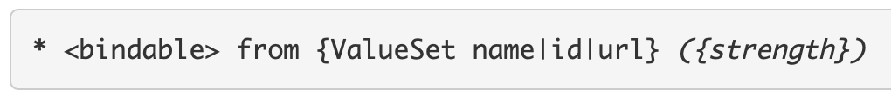
Examples of FSH – using ValueSet in profile
Set the binding to a ValueSet for a field in your profile with the ‘from’ keyword: * code from MyValueSet (extensible) * extension[patient-citizenship] .extension[code] .valueCodeableConcept from CitizenShipCodes (preferred)
See http://hl7.org/fhir/uv/shorthand/reference.html#binding-rules

Slide 39
Using FSH
Exercise FP065 – ValueSets - FSH

